Slide 1








ML Model Deployment to Particle Photon 2
Shawn Hymel

Slide 2
Agenda
Data collection
Model training
Model deployment
Static inference
Live inference

Slide 3
Official Edge Impulse Firmware
Follow directions on Docs > Development platforms > Officially supported MCU targets > Particle Photon 2
Clone github.com/edgeimpulse/firmware-particle
Register device at setup.particle.io/
Build and flash following README

Slide 4
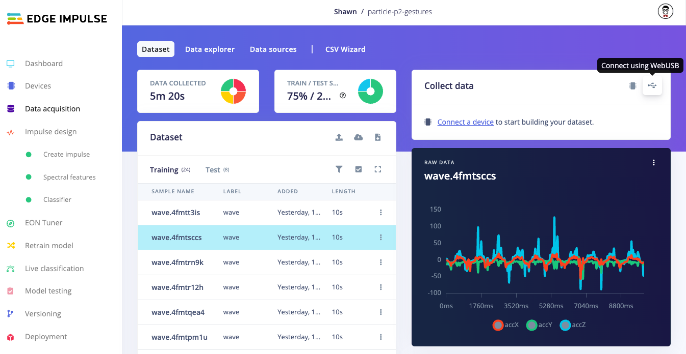
Data Collection
Flash Edge Impulse firmware to P2
Create new project in Edge Impulse Studio
Use WebUSB to collect data (Chrome only)
Start: 100s of samples per class
Alternative:
Store to SD card
Use Edge Impulse ingest service

Slide 5
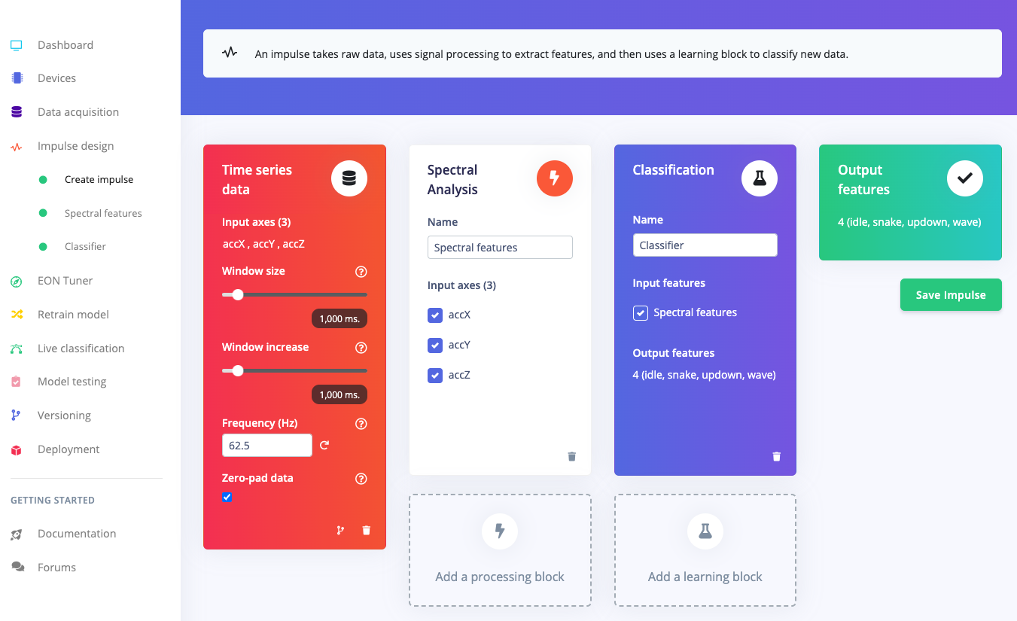
Train Machine Learning Model
Create impulse
Generate features
Train machine learning model
Examples: docs.edgeimpulse.com/docs/tutorials/end-to-end-tutorials

Slide 6
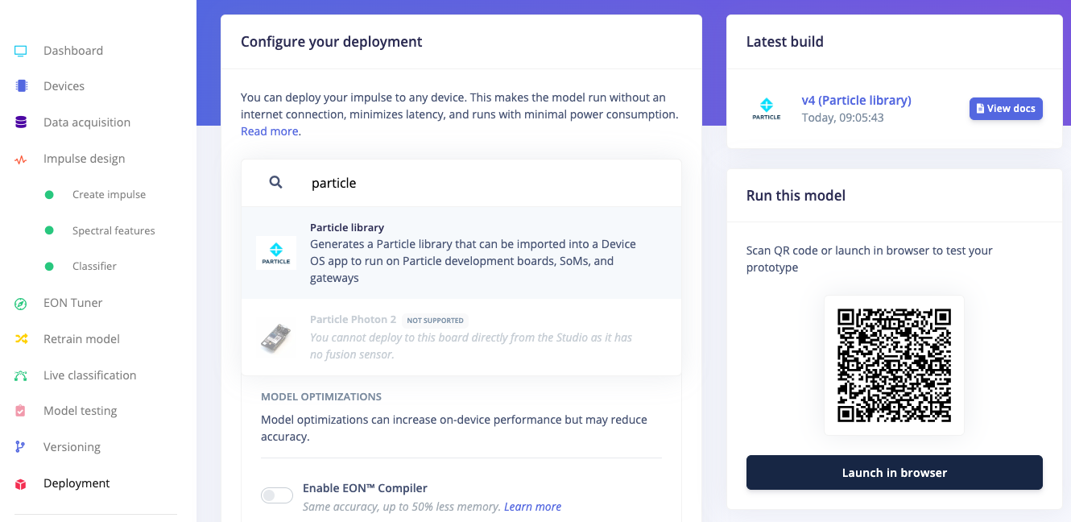
Deploy Model as Particle Library
Go to Deployment page
Search for “particle”
Select Particle library
Click “Build”

Slide 7
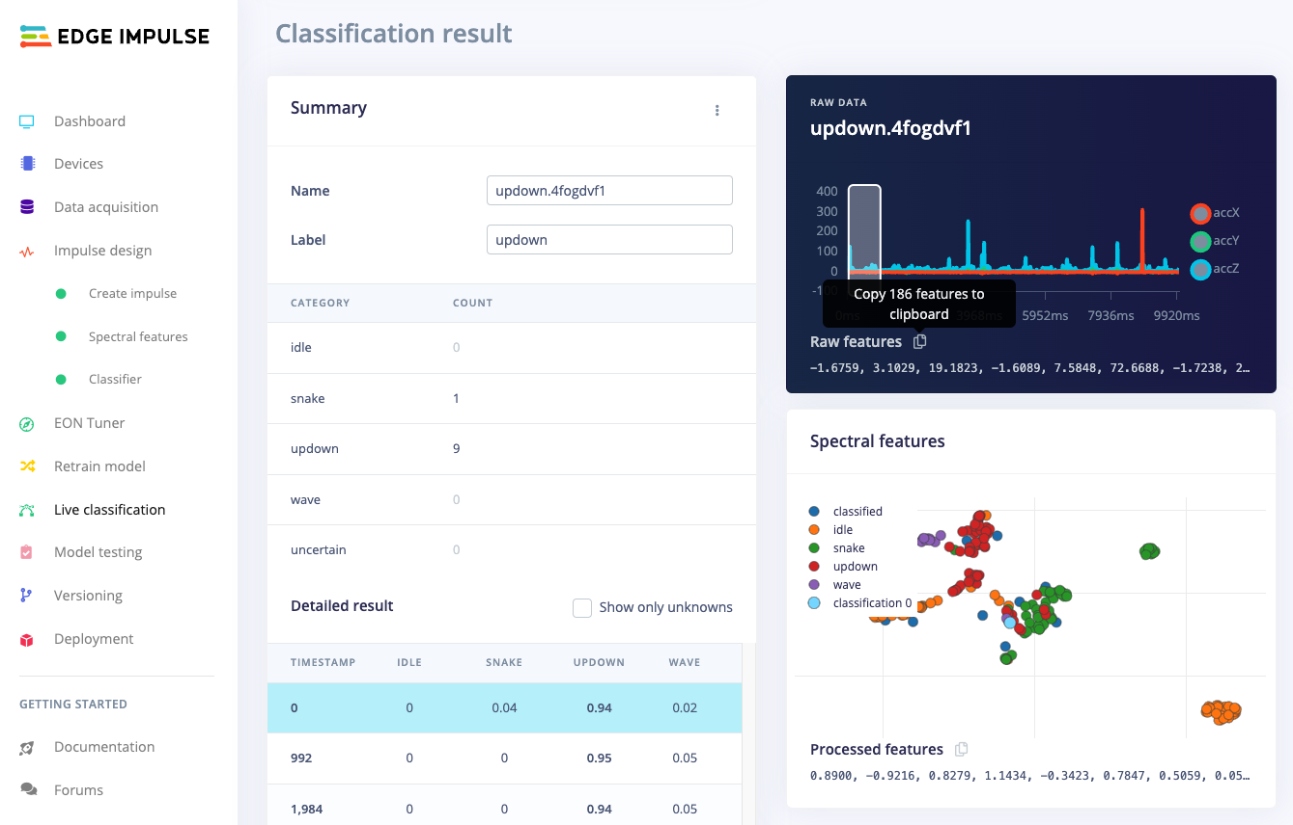
Static Inference
Test that inference works
Import project into Particle Workbench
Copy raw features from sample
Build and flash

Slide 8
Inference Pipeline
Raw features (186 values)
Processed features
(39 values)
Model:
3-layer dense neural network
Sensor
(Accel.)
Processing: Spectral features
P(idle)
P(snake)
P(updown)
P(wave)
Collect accelerometer data (3 axes) at 62.5 Hz for 1 second
run_classifier()

Slide 9
Using Inference Results
...
I_IMPULSE_ERROR res = run_classifier(&features_signal, &result, false);
...
ei_printf("Predictions:\r\n");
for (uint16_t i = 0; i < EI_CLASSIFIER_LABEL_COUNT; i++) {
ei_printf(" %s: ", ei_classifier_inferencing_categories[i]);
ei_printf("%.5f\r\n", result.classification[i].value);
}
P(<label>)

Slide 10
Inference Pipeline
Raw features (186 values)
Processed features
(39 values)
Model:
3-layer dense neural network
Sensor
(Accel.)
Processing: Spectral features
P(idle)
P(snake)
P(updown)
P(wave)
Collect accelerometer data (3 axes) at 62.5 Hz for 1 second
run_classifier()

Slide 11
Choosing a Threshold
Histogram (“snake” vs. “not snake”)
True Negatives (TN)
True Positives (TP)
Number of times a particular result occurs
0.0
1.0
Threshold: 0.5
Confidence score
(for label “snake”): P_{snake}

Slide 12
Choosing a Threshold
Histogram (“snake” vs. “not snake”)
True Negatives (TN)
True Positives (TP)
Number of times a particular result occurs
False Positives (FP)
0.0
1.0
False Negatives (FN)
Threshold: 0.5
Confidence score
(for label “snake”): P_{snake}

Slide 13
Choosing a Threshold
Histogram (“snake” vs. “not snake”)
True Negatives (TN)
True Positives (TP)
Number of times a particular result occurs
False Positives (FP)
0.0
1.0
False Negatives (FN)
Threshold: 0.3
Confidence score
(for label “snake”): P_{snake}

Slide 14
Choosing a Threshold
Histogram (“snake” vs. “not snake”)
True Negatives (TN)
True Positives (TP)
Number of times a particular result occurs
0.0
1.0
False Negatives (FN)
Threshold: 0.7
Confidence score
(for label “snake”): P_{snake}

Slide 15
Going Further
This workshop
github.com/edgeimpulse/workshop-particle-p2-inference
Documentation
docs.edgeimpulse.com/docs/development-platforms/officially-supported-mcu-targets/particle-photon-2
github.com/edgeimpulse/firmware-particle
Project ideas
docs.edgeimpulse.com/docs/tutorials/end-to-end-tutorials
edgeimpulse.com/projects/overview
hackster.io/EdgeImpulse/projects

